Slide 1
Data Communications and Networking
Chapter 10
Circuit Switching and Packet Switching
References:
Book Chapter 10.1 , 10.2, 10.5
Data and Computer Communications, 8th edition
By William Stallings

Slide 2
Overview
Networks are used to interconnect many devices.
We have checked with Local Area Networks.
Now, wide area networks
  Since the invention of the telephone, circuit switching has been the dominant technology for voice communications.
  Since 1970, packet switching has evolved substantially for digital data communications. It was designed to provide a more efficient facility than circuit switching for bursty data traffic.
    Two types of packet switching:
      Datagram (such as today’s Internet)
      Virtual circuit (such as Frame Relay, ATM)

Slide 3
Switched Communications Networks
Long distance transmission between stations (called “end devices”) is typically done over a network of switching nodes.
Switching nodes do not concern with content of data. Their purpose is to provide a switching facility that will move the data from node to node until they reach their destination (the end device).
A collection of nodes and connections forms a communications network.
In a switched communications network, data entering the network from a station are routed to the destination by being switched from node to node.

Slide 4
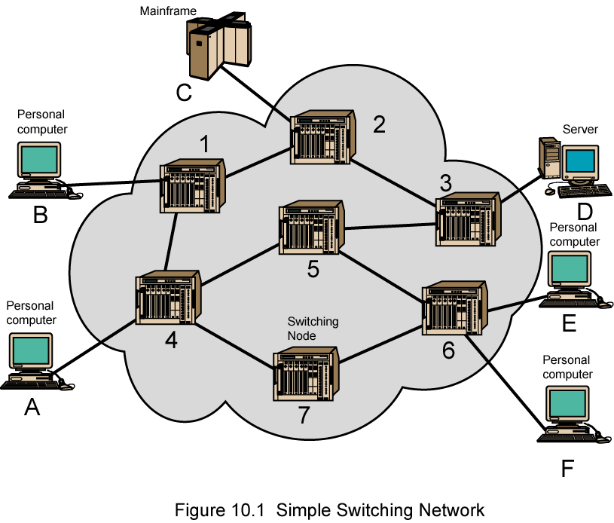
Simple Switching Network

Slide 5
Switching Nodes
Nodes may connect to other nodes, or to some stations.
Network is usually partially connected
  However, some redundant connections are desirable for reliability
Two different switching technologies
  Circuit switching
  Packet switching

Slide 6
Circuit Switching
Circuit switching:
  There is a dedicated communication path between two stations (end-to-end)
  The path is a connected sequence of links between network nodes. On each physical link, a logical channel is dedicated to the connection.
Communication via circuit switching has three phases:
  Circuit establishment (link by link)
    Routing & resource allocation (FDM or TDM)
  Data transfer
  Circuit disconnect
    Deallocate the dedicated resources
The switches must know how to find the route to the destination and how to allocate bandwidth (channel) to establish a connection.

Slide 7
Circuit Switching Properties
Inefficiency
  Channel capacity is dedicated for the whole duration of a connection
  If no data, capacity is wasted
Delay
  Long initial delay: circuit establishment takes time
  Low data delay: after the circuit establishment, information is transmitted at a fixed data rate with no delay other than the propagation delay. The delay at each node is negligible.
Developed for voice traffic (public telephone network) but can also applied to data traffic.
  For voice connections, the resulting circuit will enjoy a high percentage of utilization because most of the time one party or the other is talking.
  But how about data connections?

Slide 8
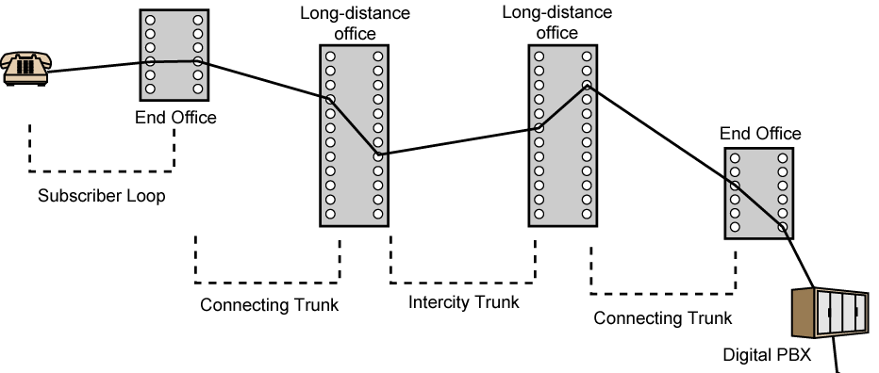
Public Circuit Switched Network
Subscribers: the devices that attach to the network.
Subscriber loop: the link between the subscriber and the network.
Exchanges: the switching centers in the network.
End office: the switching center that directly supports subscribers.
Trunks: the branches between exchanges. They carry multiple voice-frequency circuits using either FDM or synchronous TDM.

Slide 9
Packet Switching Principles
Problem of circuit switching
  designed for voice service
  Resources dedicated to a particular call
  For data transmission, much of the time the connection is idle (say, web browsing)
  Data rate is fixed
    Both ends must operate at the same rate during the entire period of connection
Packet switching is designed to address these problems.

Slide 10
Basic Operation
Data are transmitted in short packets
  Typically at the order of 1000 bytes
  Longer messages are split into series of packets
  Each packet contains a portion of user data plus some control info
Control info contains at least
  Routing (addressing) info, so as to be routed to the intended destination
  Recall the content of an IP header!
store and forward
  On each switching node, packets are received, stored briefly (buffered) and passed on to the next node.

Slide 11
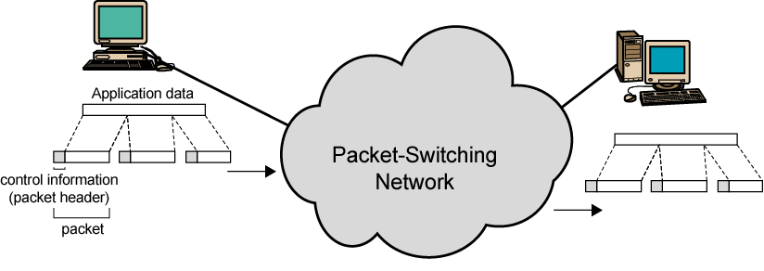
Use of Packets

Slide 12
Advantages of Packet Switching
Line efficiency
  Single node-to-node link can be dynamically shared by many packets over time
  Packets are queued up and transmitted as fast as possible
Data rate conversion
  Each station connects to the local node at its own speed
In circuit-switching, a connection could be blocked if there lacks free resources. On a packet-switching network, even with heavy traffic, packets are still accepted, by delivery delay increases.
Priorities can be used
  On each node, packets with higher priority can be forwarded first. They will experience less delay than lower-priority packets.

Slide 13
Packet Switching Technique
A station breaks long message into packets
Packets are sent out to the network sequentially, one at a time
How will the network handle this stream of packets as it attempts to route them through the network and deliver them to the intended destination?
  Two approaches
    Datagram approach
    Virtual circuit approach

Slide 14
Datagram
Each packet is treated independently, with no reference to packets that have gone before.
  Each node chooses the next node on a packet’s path.
Packets can take any possible route.
Packets may arrive at the receiver out of order.
Packets may go missing.
It is up to the receiver to re-order packets and recover from missing packets.
Example: Internet

Slide 15
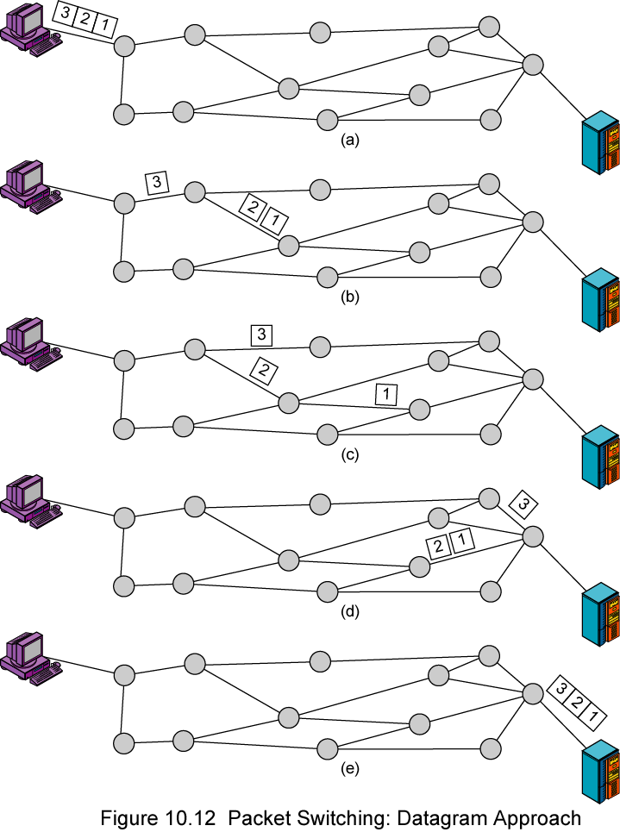
Datagram

Slide 16
Virtual Circuit
In virtual circuit, a preplanned route is established before any packets are sent, then all packets follow the same route.
Each packet contains a virtual circuit identifier instead of destination address, and each node on the preestablished route knows where to forward such packets.
  The node need not make a routing decision for each packet.
Example: X.25, Frame Relay, ATM

Slide 17
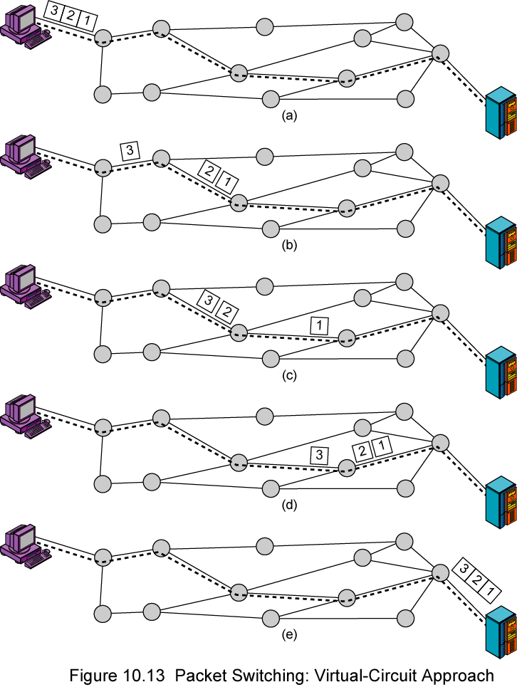
Virtual
Circuit
A route between stations is set up prior to data transfer.
All the data packets then follow the same route.
But there is no dedicated resources reserved for the virtual circuit! Packets need to be stored-and-forwarded.

Slide 18
Virtual Circuits v Datagram
Virtual circuits
  Network can provide sequencing (packets arrive at the same order) and error control (retransmission between two nodes).
  Packets are forwarded more quickly
    Based on the virtual circuit identifier
    No routing decisions to make
  Less reliable
    If a node fails, all virtual circuits that pass through that node fail.
Datagram
  No call setup phase
    Good for bursty data, such as Web applications
  More flexible
    If a node fails, packets may find an alternate route
    Routing can be used to avoid congested parts of the network

Slide 19
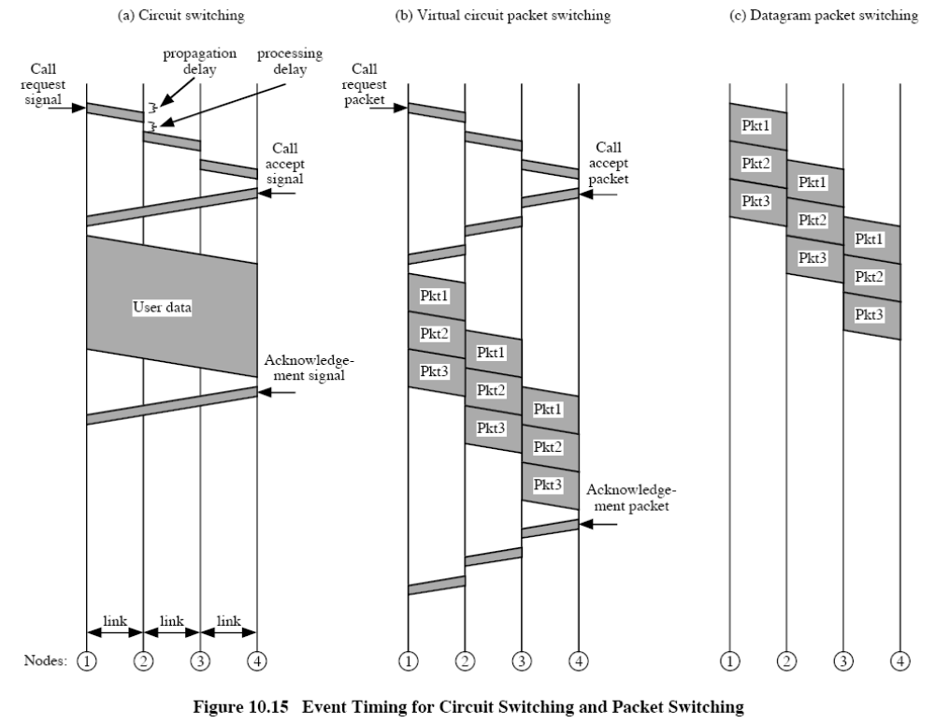

Slide 20
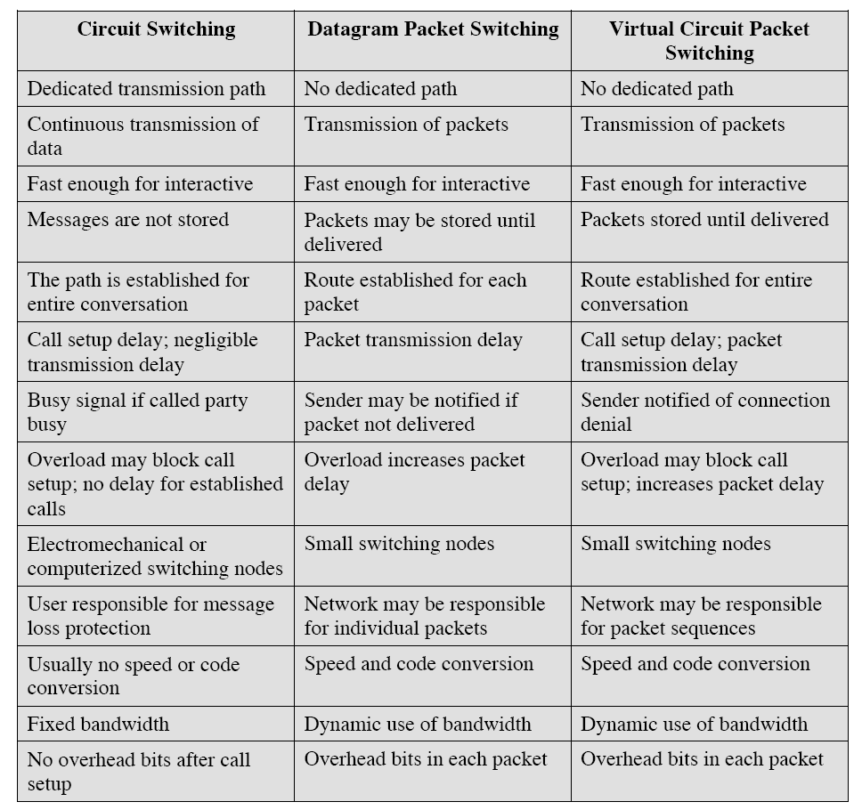
Comparison of communication switching techniques

